Slide 1
Subsidies to Overfish our Oceans
The WTO Agreement on Fisheries Subsidies:
A tool to stop harmful subsidies
An opportunity to use the WTO to address a global commons problem
Christine McDaniel

Slide 2
Future Fisheries Management Workshop June 2023
This issue is about global overfishing.
But for trade economists and analysts it’s about how we will solve the increasingly complex trade issues of tomorrow.
We need more research on:
Access agreements
Descriptive and empirical
Monitoring techniques and fish stocks
Descriptive and empirical
Bottom-up implementation for global agreements
Global commons problems
Global overfishing
Space junk
So much more

Slide 3
Future Fisheries Management Workshop Mercatus Center at George Mason University Center for Governance and Markets at the University of Pittsburgh June 2023
Mobilize scholars and policy experts to craft effective and innovative solutions
Produce research papers on the causes and solutions
Provide novel solutions and implementation techniques for entities like the WTO
Key findings:
Focus on bottom-up solutions
Leverage existing international agreements
Swift implementation and technical assistance for developing countries
Watch the video on the workshop:
https://youtu.be/fPdVVIbfnVs

Slide 4
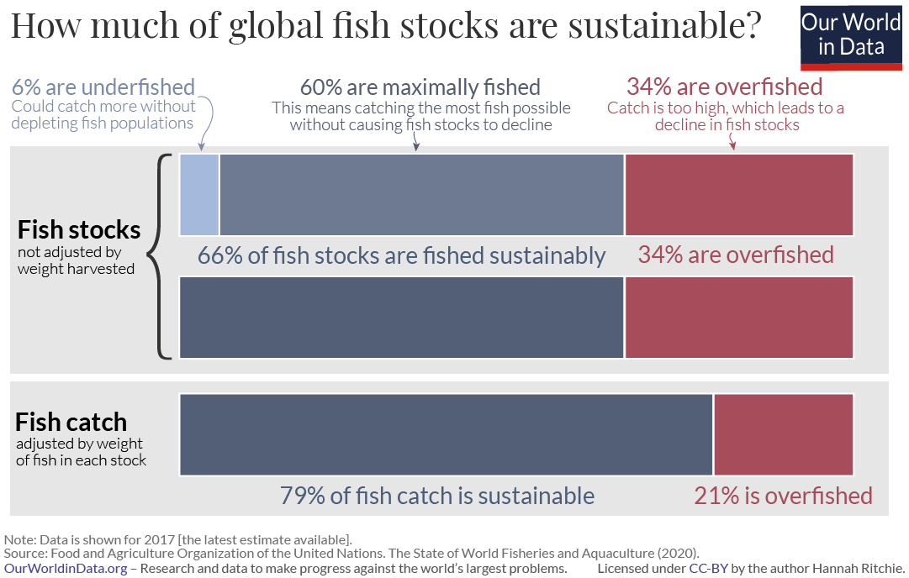

Slide 5
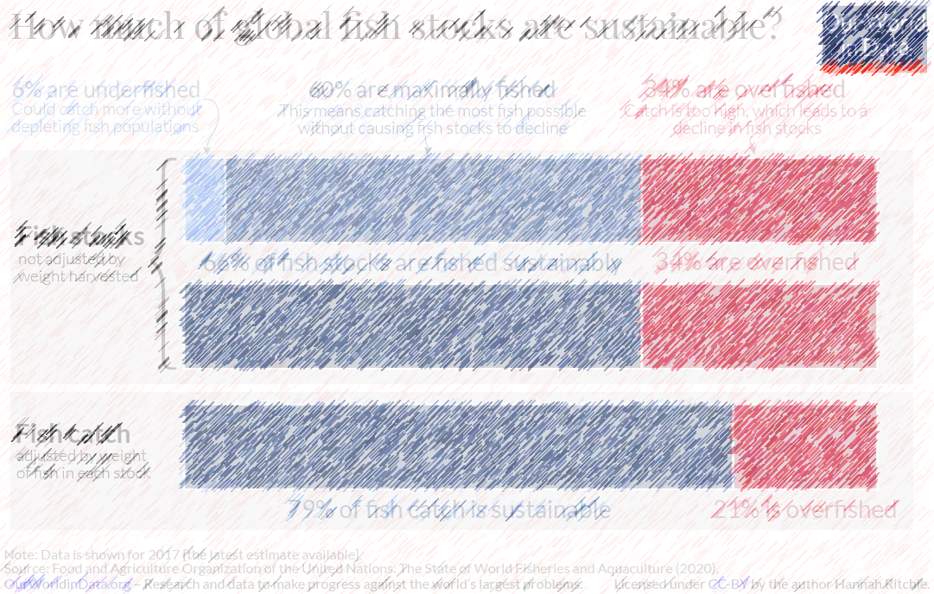
The pollock fishery of the central Bering Sea.
It would be one of the largest fisheries in the world if it still existed, but overfishing led to its collapse.
A fishing “moratorium” in that area was declared in the 1990s, but only after the area was maximally fished.
It was unable to recover.

Slide 6
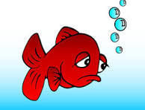
The pollock fishery of the central Bering Sea.
It would be one of the largest fisheries in the world if it still existed, but overfishing led to its collapse.
A fishing “moratorium” in that area was declared in the 1990s, but only after the area was maximally fished.
It was unable to recover.

Slide 7
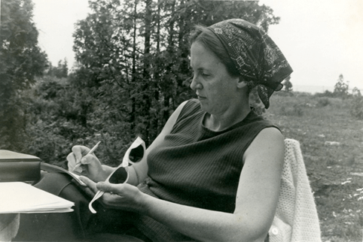
This is a textbook case of the tragedy of the commons
But this one is global commons resource problem
Nobel laureate Elinor Ostrom
Awarded for her analysis of economic governance
She demonstrated how common property could be successfully managed by groups using it.
If you catch it before me, then it’s yours.
But if I catch it before you, then it’s mine.
When a common resource is left unmanaged, individuals act in their own interest and ultimately deplete the resource.

Slide 8
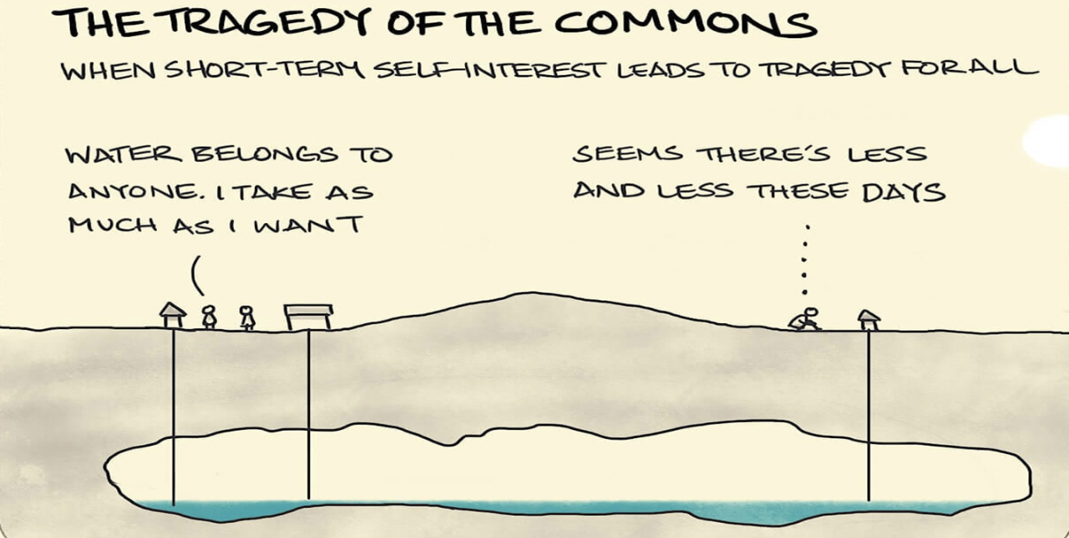
This is a textbook case of the tragedy of the commons
But this one is global commons resource problem
If you catch it before me, then it’s yours.
But if I catch it before you, then it’s mine.
When a common resource is left unmanaged, individuals act in their own interest and ultimately deplete the resource.

Slide 9
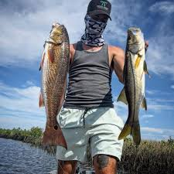

Slide 10
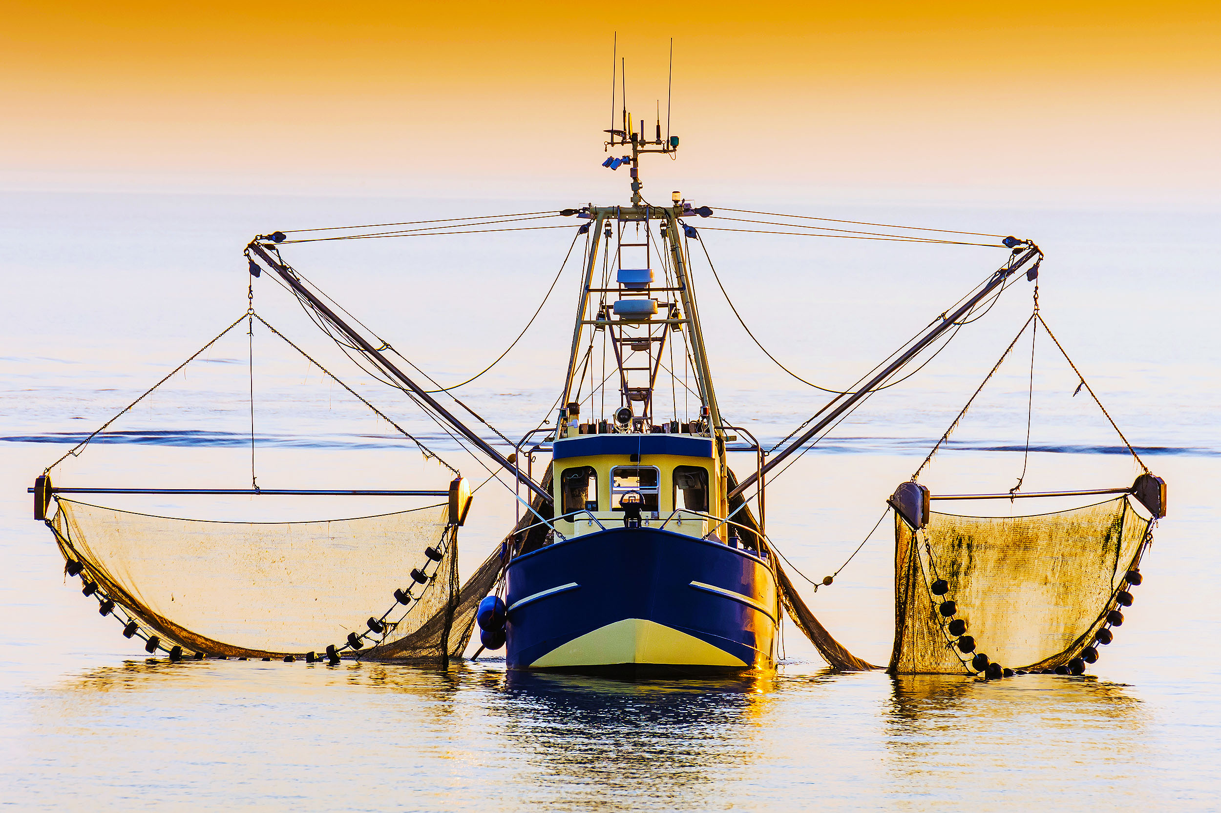
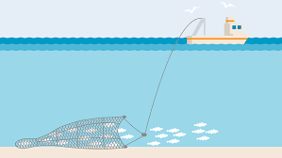

Slide 11
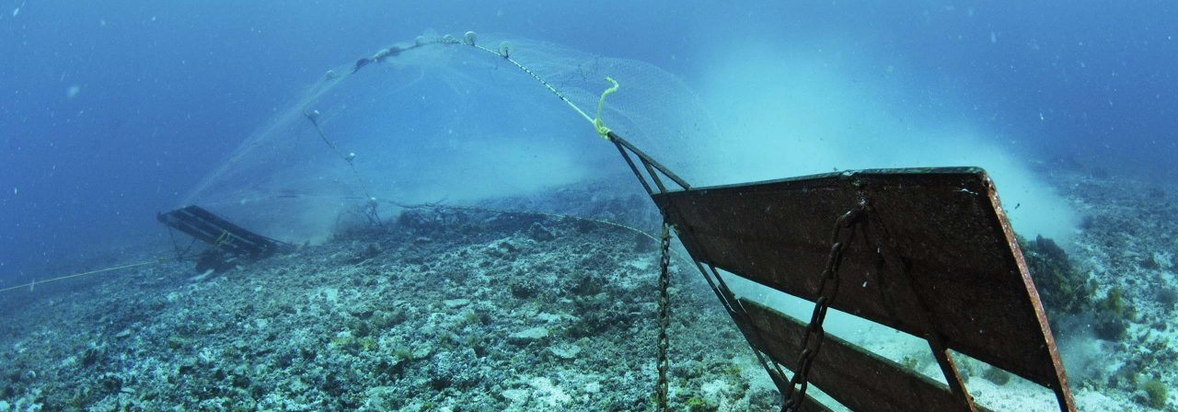

Slide 12
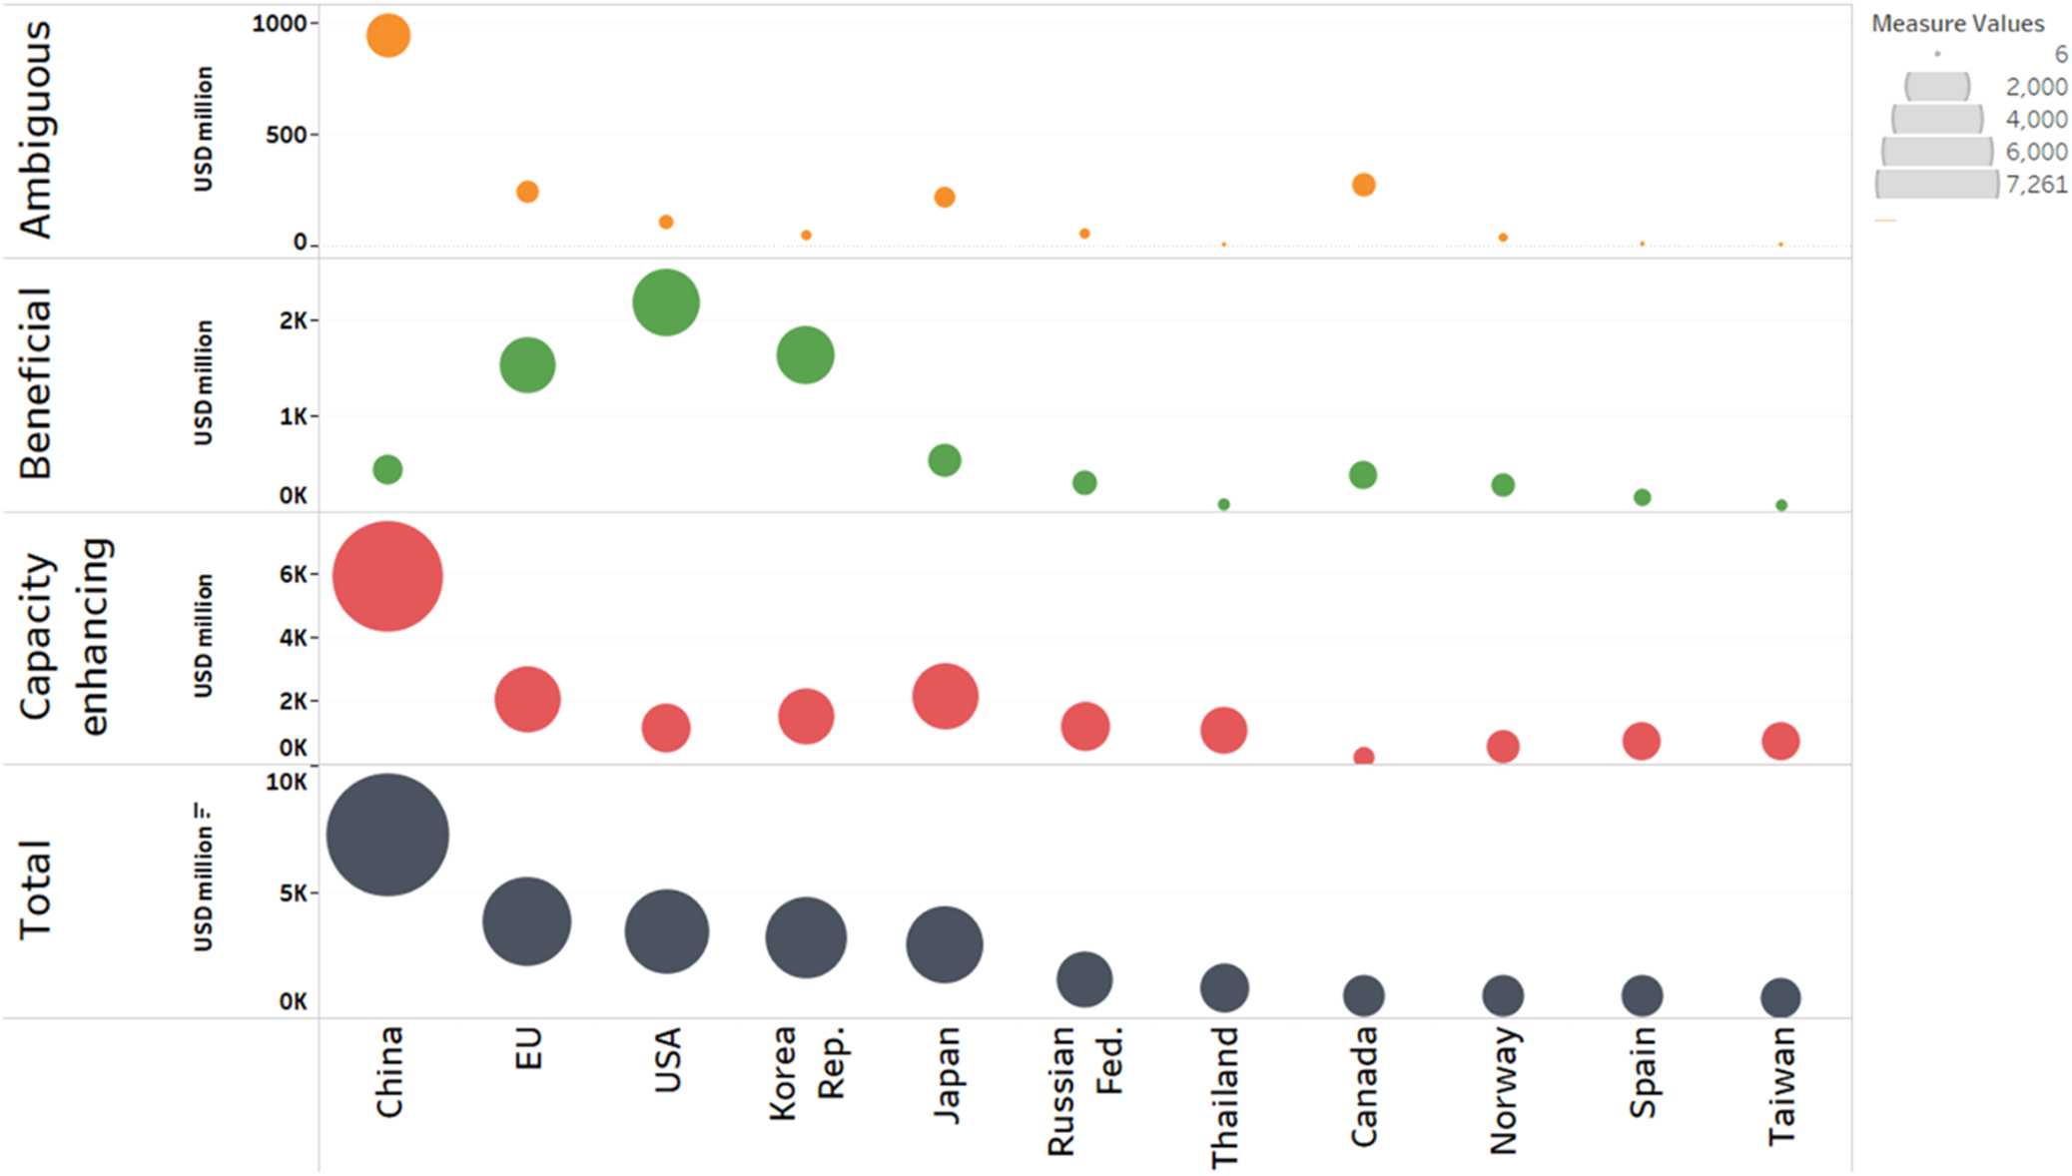
Top subsidizing nations/political entities in 2018 (amount in million USD) by category of subsidy (i.e., ambiguous, capacity-enhancing, and beneficial)6 and total.
Source: “WTO must complete an ambitious fisheries subsidies agreement,” https://www.nature.com/articles/s44183-024-00042-0

Slide 13
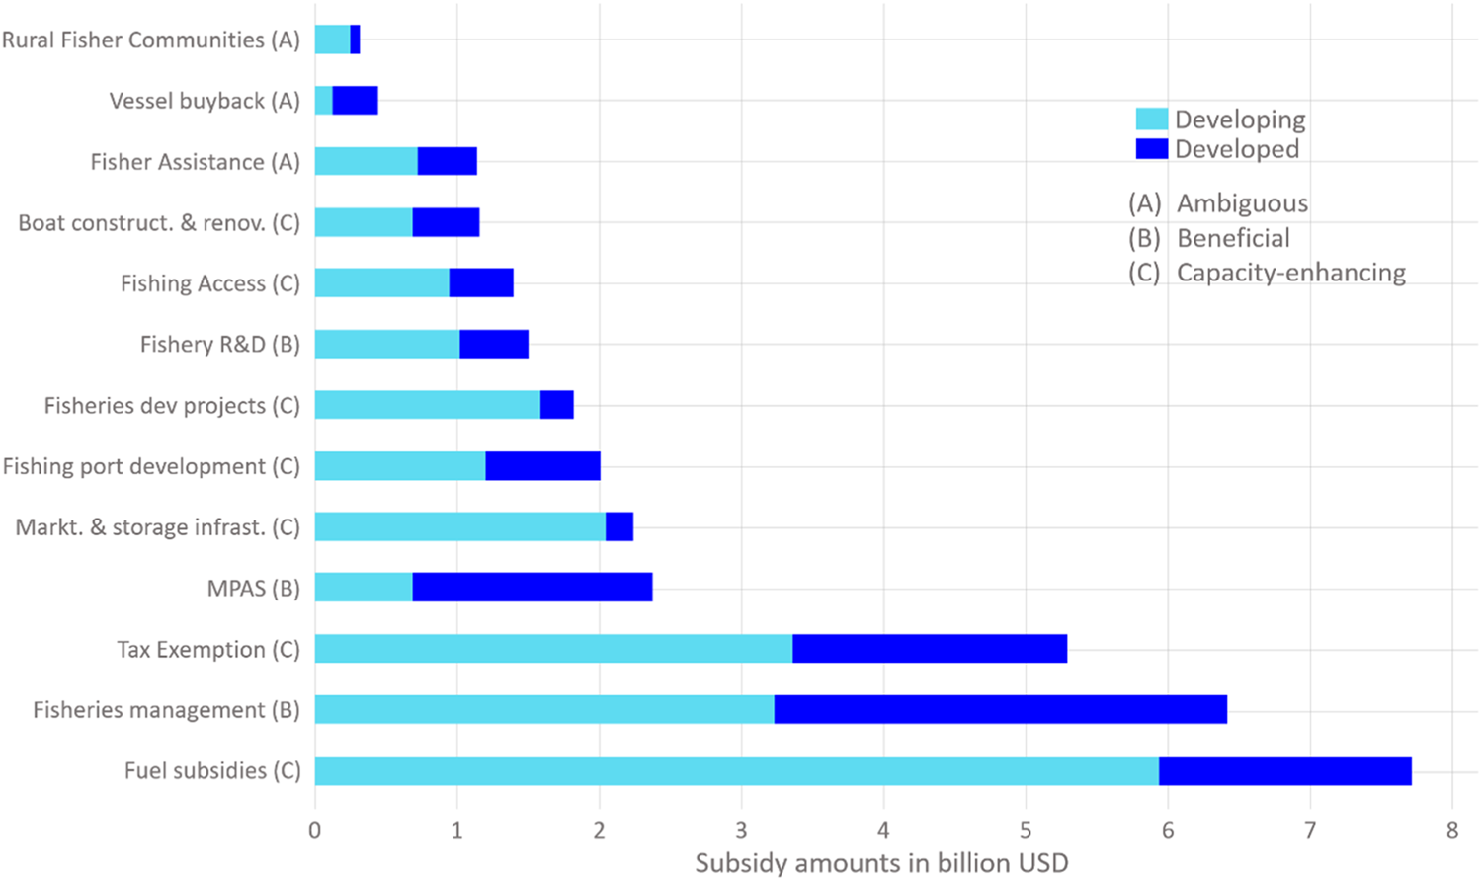
Fisheries subsidies amount by category and type and grouped by developed and developing country groups (dark vs. light blue, respectively), for 2018
Source: “WTO must complete an ambitious fisheries subsidies agreement,” https://www.nature.com/articles/s44183-024-00042-0

Slide 14
Directions for Further Research
We need more research on:
Access agreements
Descriptive and empirical
Monitoring techniques and fish stocks
Descriptive and empirical
Bottom-up implementation for global agreements
Global commons problems
Global overfishing
Space junk
So much more

Slide 15
Thank you!

